Slide 1

Ride-Sharing App with Driver and Rider Matching.
1

Slide 2

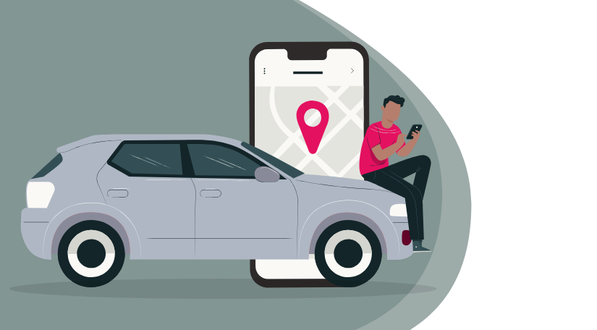
2
santosh_yarrabotula -AP23110011421
praveen_vemulapati - AP23110011455
venkat_ketharajupalli -AP23110011456
premkumar_meruva -AP23110011463

Slide 3

3
Introduction:
Basic features of the app :
Matching Drivers and Riders: The app finds and matches riders with available drivers based on location and vehicle type.
Support for Different Vehicles: It allows different types of vehicles like cars, bikes, and taxis, each with its own pricing and features.
Error Handling: It manages common problems, like when no drivers are available or when incorrect inputs are given.

Slide 4
3
Features and Functionalities:
User Roles and Profiles
Drivers
Riders
Vehicle Types
Supported Vehicle Options
Customization
.

Slide 5
Inheritance:
VECHILE:
Attributes:Cost/km,
Distance.
Void calculatecost();
HERE MULTILEVEL INHERITANCE IS USED.
THE BASE CLASS IS VECHILE CLASS.
THE DERIVED CLASSES ARE CAR , TAXI , BIKE.
THESE THREE CLASSES ARE INHERITING MEMBERS VARIABLES COSTPERKM,DISTANCE .
THESE THREE DERIVED CLASSES ARE INHERITING A MEMBER FUNCTION CALCULATE COST.
CAR
TAXI
BIKE

Slide 6
Polymorphism:
->HERE RUN TIME POLYMORPHISM IS USED.
->BY USING VIRTUAL KEYWORD WE ARE ATTAINING
THE POLYMORPHISM.
->IN THESE CODE WE ARE USING WE ARE YOU USING
A MEMBER FUNCTION CALCULATE COST();

Slide 7

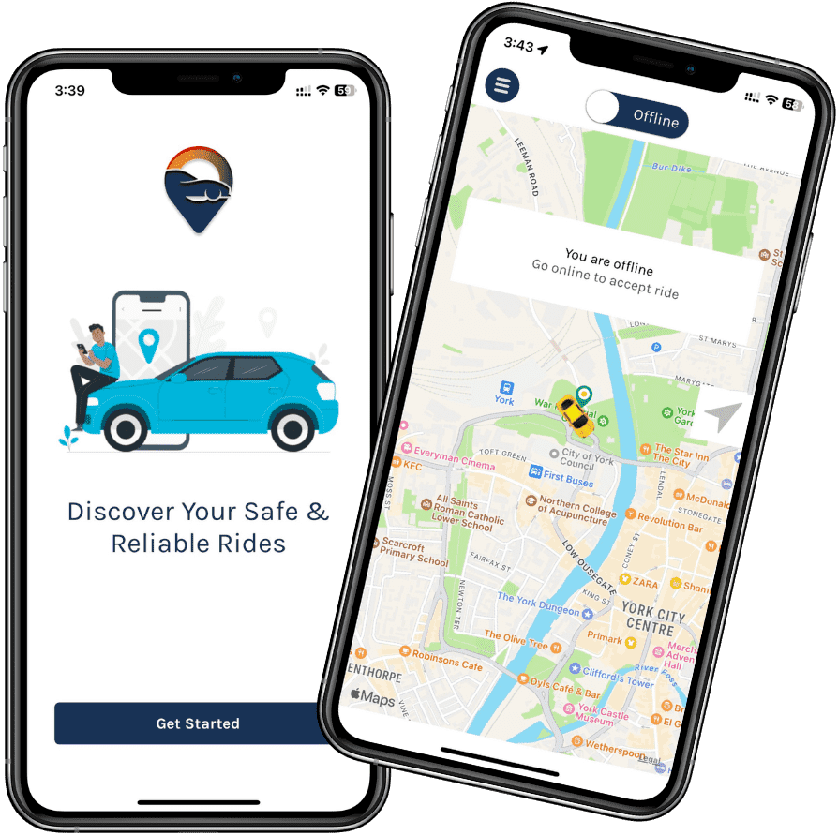
3
Distance & Price Calculation Vehicle Pricing:
Bike: 1 km = 8 Rupees
Car: 1 km = 12 Rupees
Taxi: 1 km = 10 Rupees
Price Calculation Formula:
Total Price = Distance (in km) × Rate per km

Slide 8
3
Exception Handling:
Goal: Ensure smooth matching of drivers and riders.
Common Issues:
Invalid Location: Validate and prompt for correction.
Driver Rejection: Retry with another driver.
Payment Failures: Retry or prompt for alternate payment.
Solution:
Retry Mechanisms
User Notifications

Slide 9
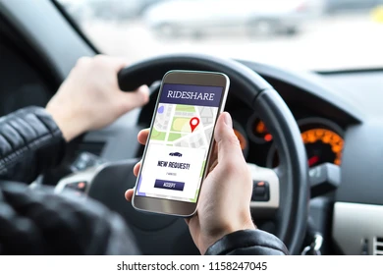

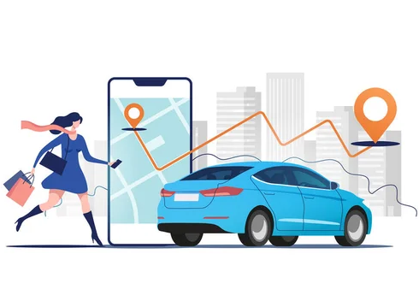
Future Scope:
AI-Powered Ride Matching:
Use machine learning to optimize driver-rider matching, improving efficiency and user satisfaction.
Autonomous Vehicles Integration:
Explore self-driving cars to enhance convenience and reduce dependence on human drivers, improving scalability and cost-efficiency.

Slide 10
4
Conclusion:
C++ is really powerful:
It lets us create a fast and smart system to match riders and drivers in real time.
This app can grow:
Using C++, we can easily add new features like carpooling or predicting busy times.
It solves real problems:
By making transportation easy, quick, and reliable, this app can help both riders and drivers.

Slide 11

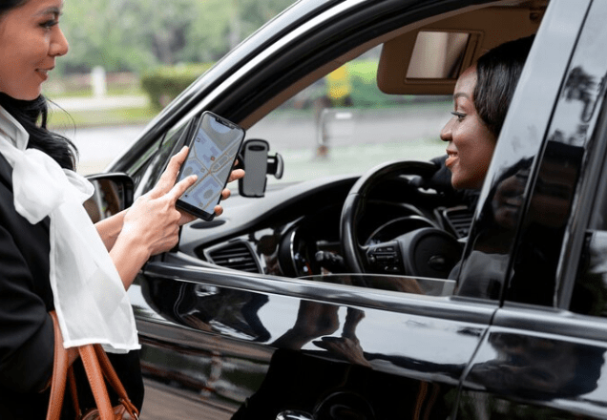
Thank you
.

